Slide 1

Generating String in SIM
Researcher: Mohammad Hossein Shafiee

Slide 2
Introduction
SIM cards play a vital role in secure communication, and generating unique or random strings is an essential part of their functionality. These strings are used for tasks like authentication, OTP generation, and session management. Given the limited resources of SIM cards—such as low memory and processing power—it's crucial to use lightweight and efficient algorithms. This presentation introduces various methods for generating strings, including basic techniques like counters and timestamps, as well as more structured approaches like Linear Congruential Generators (LCG), Linear Feedback Shift Registers (LFSR), and Nonlinear Feedback Shift Registers (NFSR). Each method is analyzed for its practicality, efficiency, and compatibility with the SIM card's environment.

Slide 3
Generating String Methods
Using a counter
  We can have A simple counter that increments with each APDU request.
  Result = counter % 10 ^ 8
  Very lightweight and fast and requires minimal resources.
  Predictable, as the next number is always known.

Slide 4
Generating String Methods
Using an Internal Timestamp
  If the SIM card can generate a timestamp, you can use it directly.
  Result = timestamp % 10 ^ 8
  Lightweight and fast and less predictable than a counter.
  Relies on hardware support for timestamps.
  Concurrent requests in the same millisecond may produce duplicate numbers.

Slide 5
Generating String Methods
Combining Counter and Timestamp
  To increase uniqueness and reduce predictability, combine the counter with the timestamp.
  Result = (counter + timestamp) % 10 ^ 8
  Very lightweight and fast and requires minimal resources.
  Predictable, as the next number is always known.

Slide 6
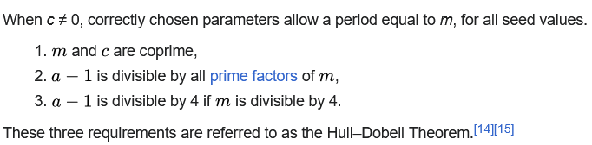
Generating String Methods
Linear Congruential Generator (LCG)
  LCG is a simple and fast method for generating pseudo-random numbers
  Seed = ( a × seed + c ) % m
  Outputs pseudo-random numbers and less predictable than counters.
  We could follow these rules to make the most efficiency. Also, we could choose m as a very large number.

Slide 7
Generating String Methods
Cryptographic Algorithms (HMAC or SHA-256)
  For high security and unpredictability, use cryptographic algorithms with a secret key or fixed data as input.
  Highly secure and unpredictable.
  High resource consumption.

Slide 8
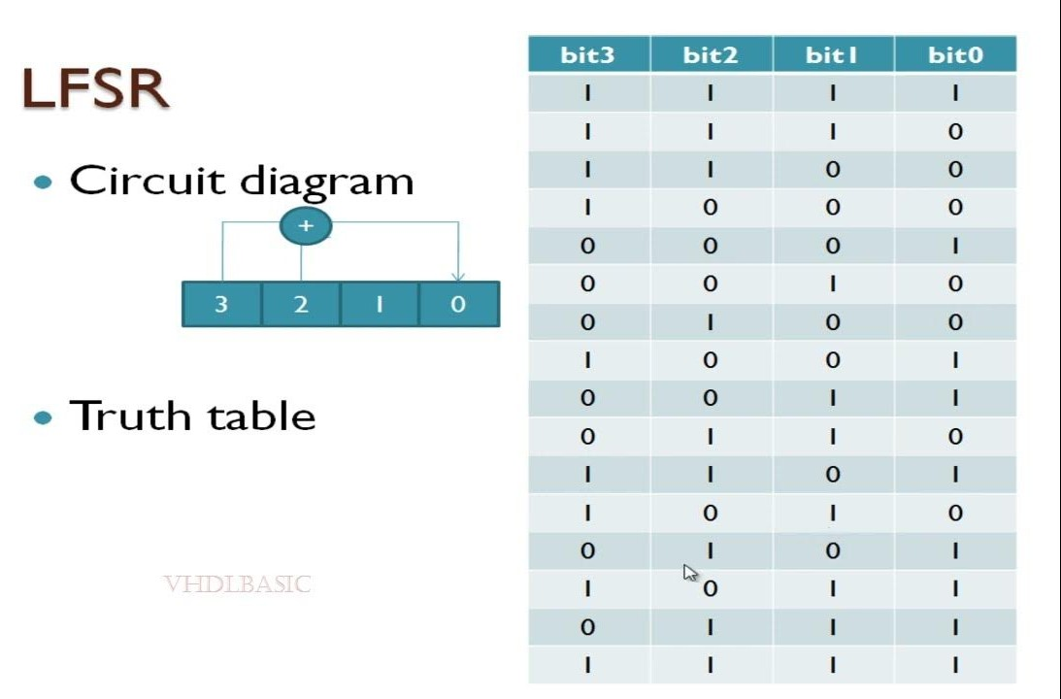
Generating String Methods
Using Hardware RNG (Random Number Generator)
  We can use LFSR or NFSR to generate a random number.

Slide 9
Conclusion
In conclusion, generating unique or random strings on SIM cards requires a careful balance between efficiency, resource usage, and security. Basic methods like counters and timestamps offer simplicity and low resource consumption but may lack randomness. Advanced techniques such as LCG, LFSR, and NFSR provide greater flexibility and better randomness, making them suitable for more robust applications, albeit with slightly higher complexity. The choice of method ultimately depends on the specific use case and the constraints of the SIM card environment. By selecting the right approach, it is possible to achieve a secure and reliable solution that meets the requirements of modern SIM card applications.

